Slide 1
TEXT SUMMARIZATION
GVHD: Ths.Nguyễn Hồng Bửu Long
SVTH: Nguyễn Văn Thịnh
Hồ Khả Việt Huấn
Lâm Phước Đạt

Slide 2
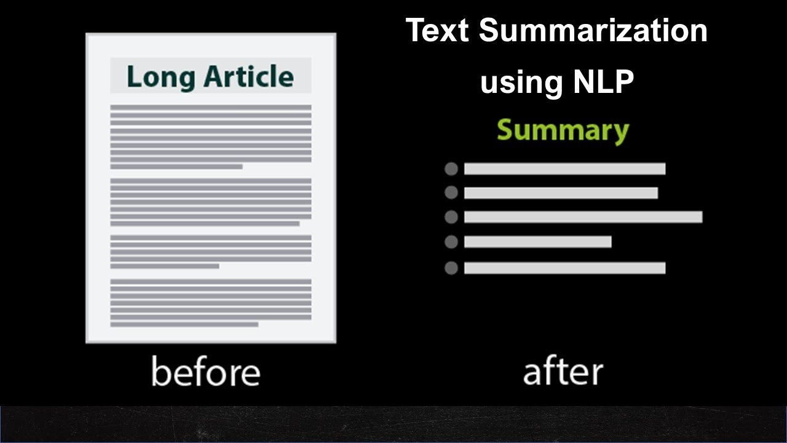
I. INTRODUCTION
Text summarization is process of distilling the most important information from a source text.

Slide 3
I. INTRODUCTION
Applications
News Summarization
Sentiment Summarization
Story/Novel Summarization
Legal Documents Summarization

Slide 4
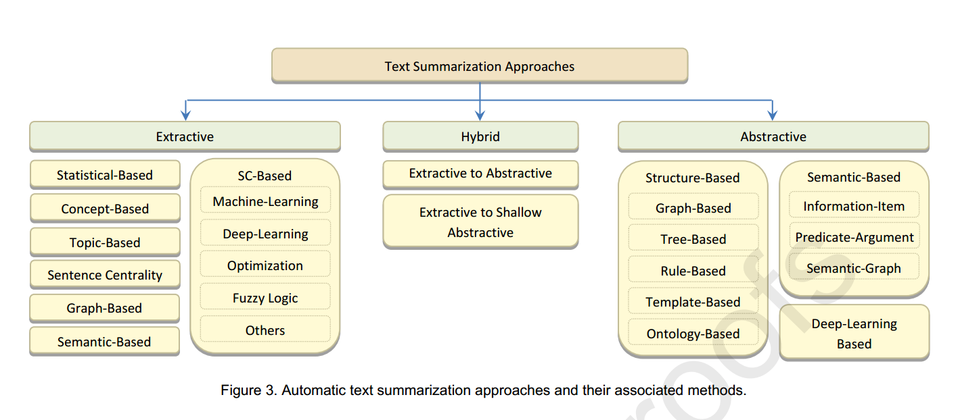
III. APPROACHES

Slide 5
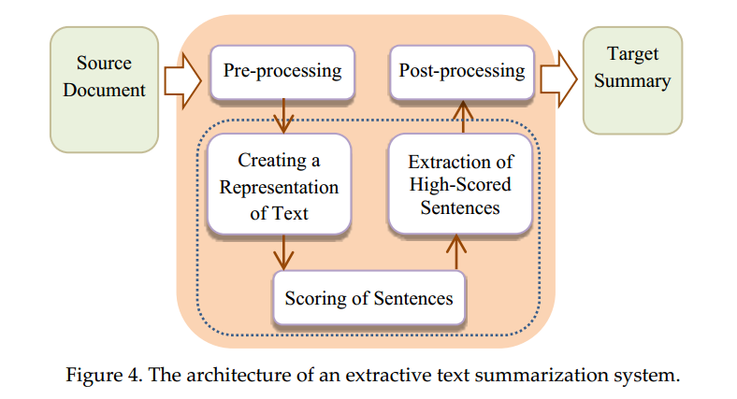
III. APPROACHES
1. Extractive text summarization
- The extractive approach selects the most important sentences in the input document(s) then concatenates them to form the summary.

Slide 6
III. APPROACHES
1. Extractive text summarization
Advantages: The extractive approach is faster and simpler than the abstractive approach. This approach leads to a higher accuracy because of the direct extraction of sentences so readers read the summary with the exact terminologies that exist in the original text.
Disadvantages: The extractive approach is far from the method that human experts write summaries. Drawbacks:
(1) Extracted sentences can be longer than average.
(2) Lack of semantics and cohesion in summary sentences. (3) Important information spread across sentences.

Slide 7
III. APPROACHES
1. Extractive text summarization
- Methods:
+ Semantic-Based Methods: Latent Semantic Analysis (LSA) is a commonly used semantic-based extractive ATS method. LSA is an unsupervised technique that represents text semantics based on the observed co-occurrence of words.
+ Machine-Learning-Based Methods: These methods convert the summarization problem to a supervised classification problem at the sentence level. The system learns by examples to classify each sentence of the test document either as “summary” or “non-summary” class using a training set of documents.

Slide 8
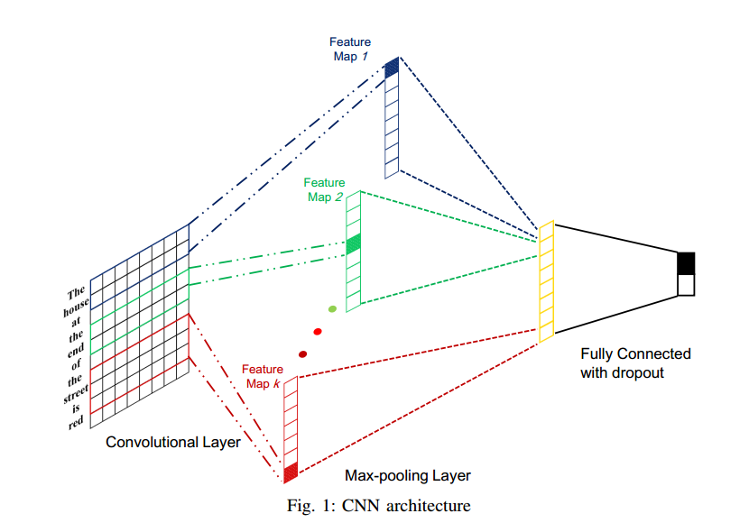
III. APPROACHES
1. Extractive text summarization
+ Deep-Learning-Based Methods: use deep learning models such as Convolutional Neural Network (CNN), Recurrent Neural Network (RNN)…

Slide 9
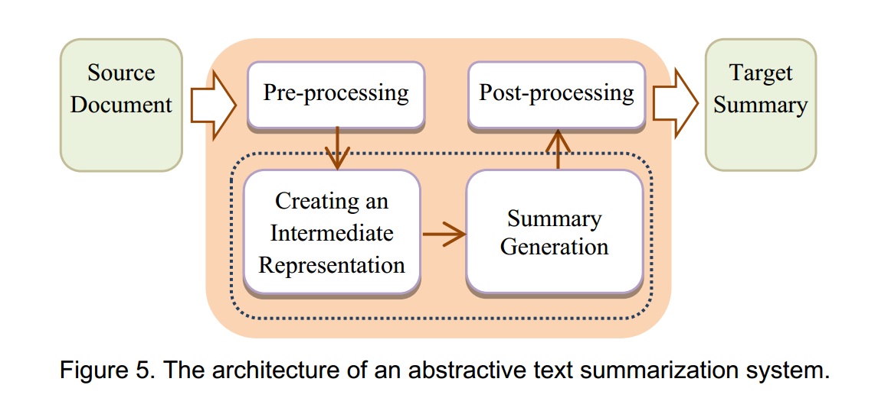
III. APPROACHES
1. Abstractive Text Summarization
- Abstractive text summarizers generate a summary by understanding the main concepts in the input document using NLP methods. So It needs a deeper analysis of the input text.

Slide 10
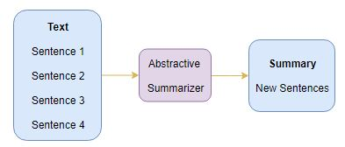
III. APPROACHES
1. Abstractive Text Summarization
- Advantages: It generates better summaries with different words that do not belong to the original text. The generated summary is closer to the manual summary.
- Disavantages: In practice, generating a high-quality abstractive summary is very difficult.

Slide 11
III. APPROACHES
1. Abstractive Text Summarization
- Methods:
+ Template-Based Methods: For some domains (e.g. meeting summaries), human summaries have shared sentence structures that can be defined as templates. Based on the input text genre, the abstractive summary can be produced by using the data in the input text to fill the slots in the suitable pre-defined templates.
+ Ontology-Based Methods: Many documents are related to specific domains and every domain has its own information structure that can be represented by a knowledge dictionary like an ontology. The basic idea is to get the proper information from the input text to form an abstractive summary by using an ontology.

Slide 12
III. APPROACHES
1. Abstractive Text Summarization
+ Deep-Learning-Based Methods: The recent success of sequence-to-sequence learning (seq2seq) makes abstractive summarization feasible. However, deep learning methods still suffer from some problems such as: generating repeated words or phrases and inability to deal with out-of-vocabulary (OOV) words.

Slide 13
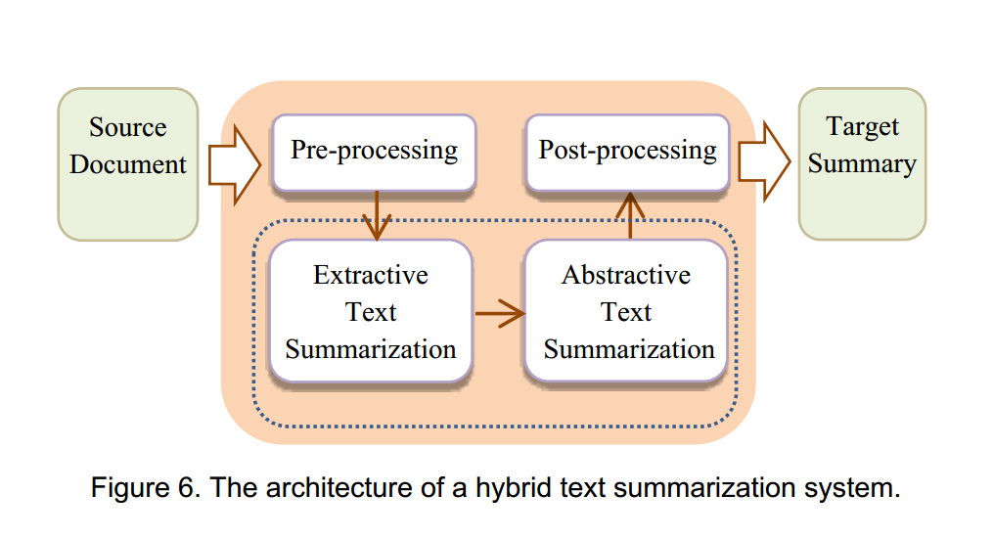
III. APPROACHES
1. Hybrid Text Summarization
- The hybrid approach combines both the abstractive and extractive approaches.

Slide 14
III. APPROACHES
1. Hybrid Text Summarization
- Advantages: combining the advantages of both extractive and abstractive approaches. The two approaches are complementary and the overall performance of summarization is improved.
- Disavantages: Generating a less quality abstractive summary than the pure abstractive approach because the generated summary depends on the extracts instead of the original text.

Slide 15
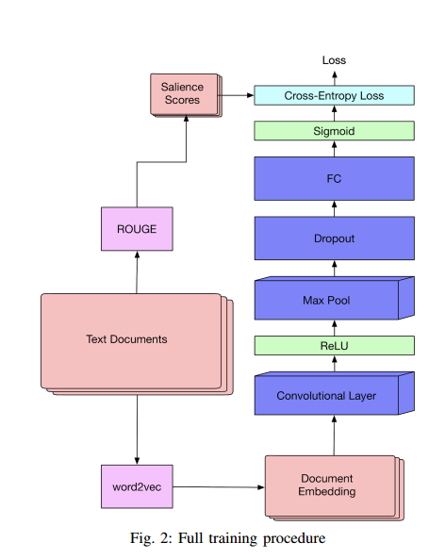
IV. OUR APPROACHE
- Extractive text summarization using Convolution Neural Network (CNN).

Slide 16
DATA
- CNN/DailyMail summarization dataset:
+ The total number of samples: 311940
+ Number of samples in training dataset: 187164, 60.0%
+ Number of samples in testing datatset: 62388, 20.0%
+ Number of samples in validation datasset: 62388, 20.0%

Slide 17
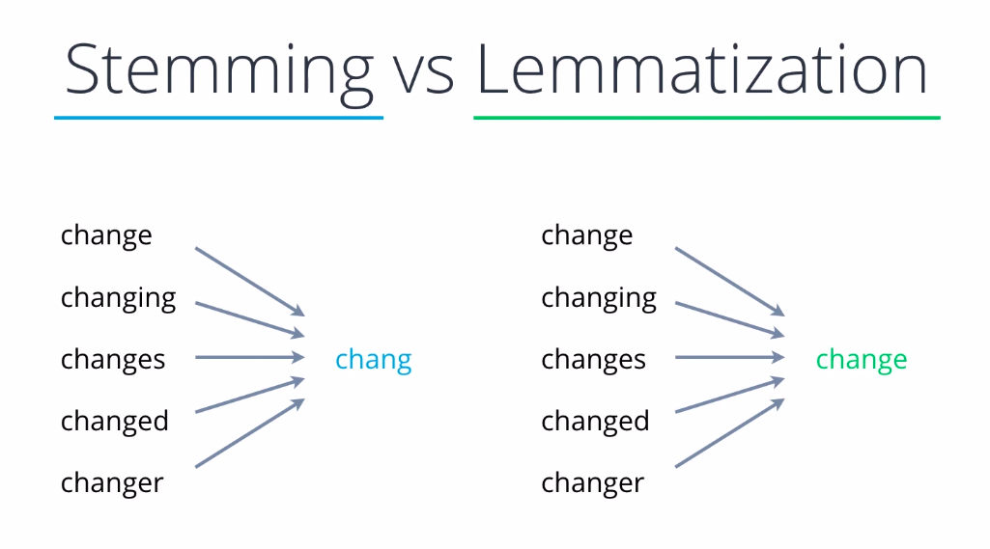
Pre Processing

Slide 18
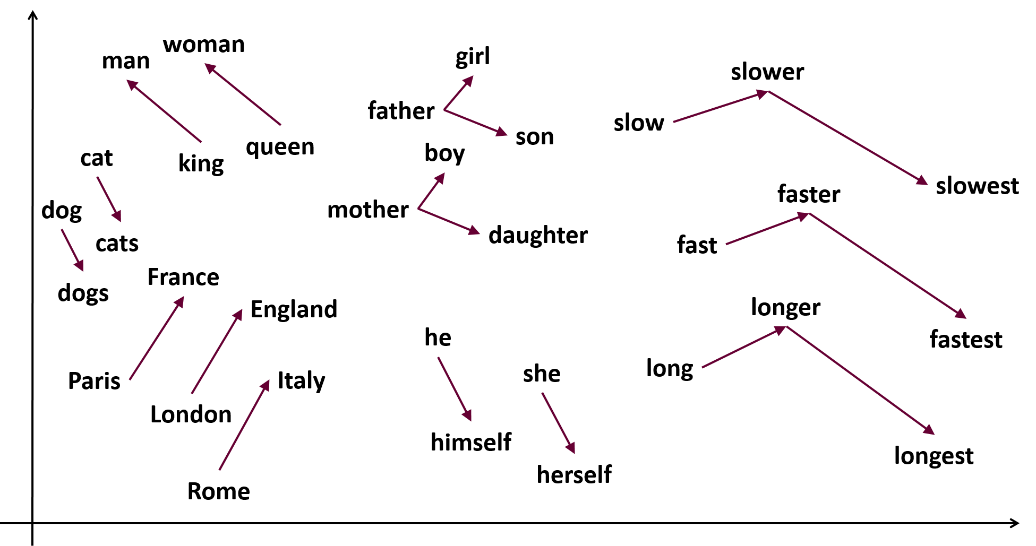
Pre Processing
Word2vec

Slide 19
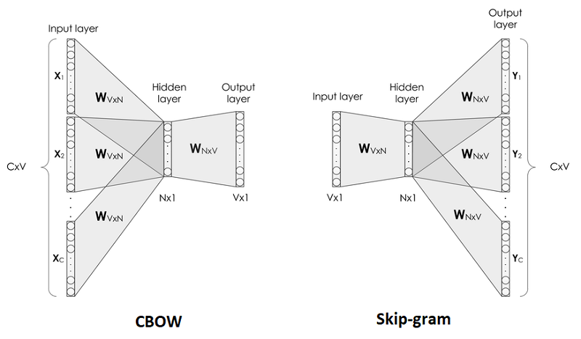
Pre Processing

Slide 20
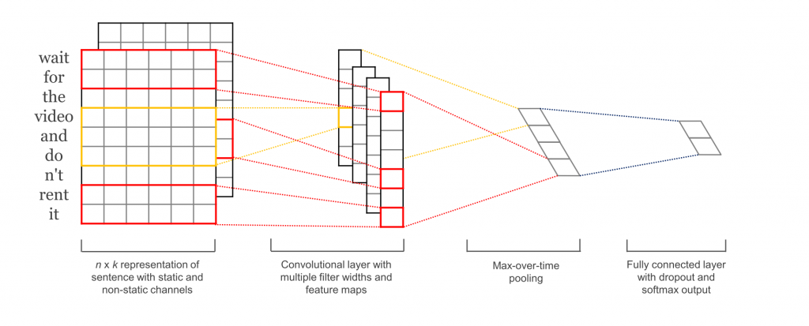
Convolutional Neural Network (CNN)

Slide 21
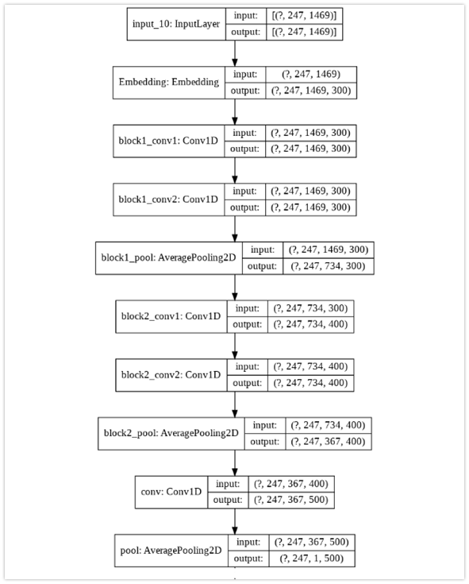
Our Model

Slide 22
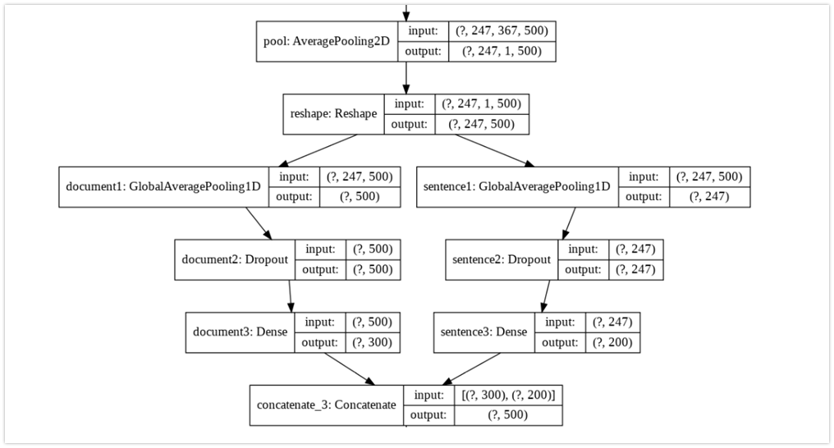
Our model

Slide 23
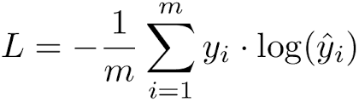
Our model
+ Loss function

Slide 24

The End.

